Slide 1


Year 1 - Technology around us
Lesson 1 – Technology in our classroom
Learner activity sheet
活动 1 – 这是科技吗?
科技
不是科技
Resources are updated regularly - the latest version is available at: the-cc.io/curriculum.
This resource is licensed by the Raspberry Pi Foundation under a Creative Commons Attribution-NonCommercial-ShareAlike 4.0 International licence. To view a copy of this license, visit, see creativecommons.org/licenses/by-nc-sa/4.0/
Notes:
Last updated: 03-06-21

Slide 2
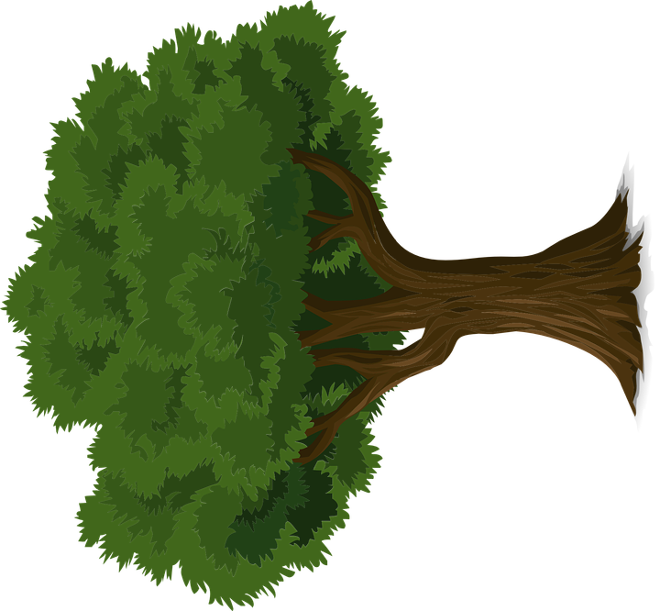
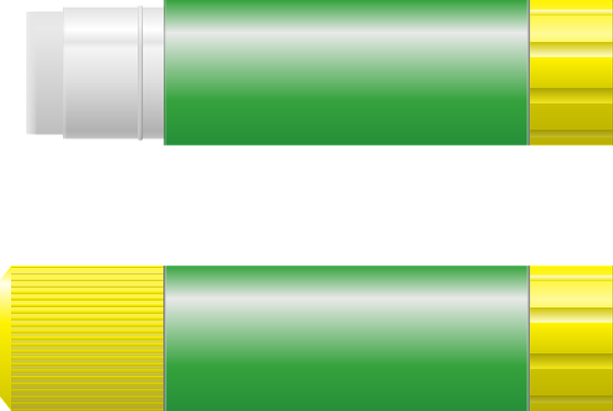

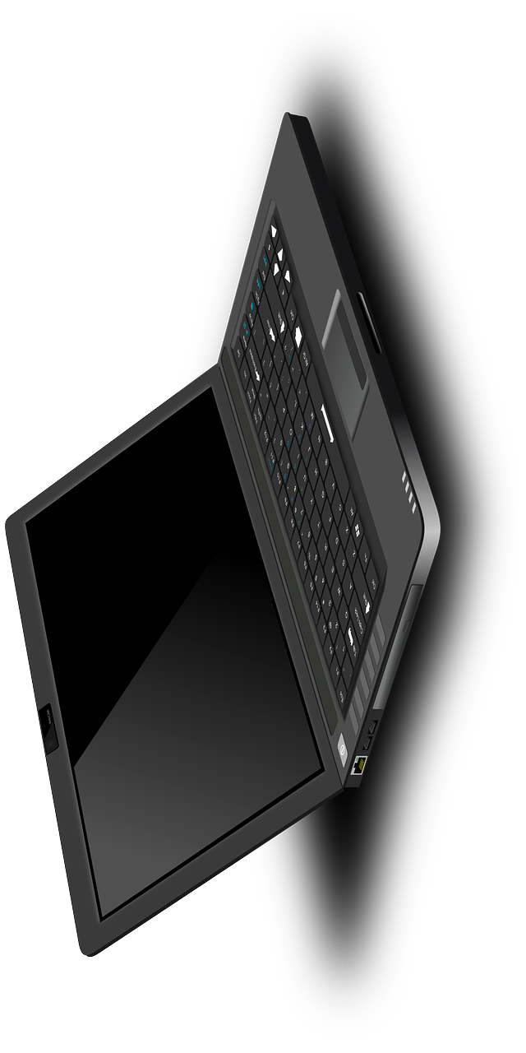
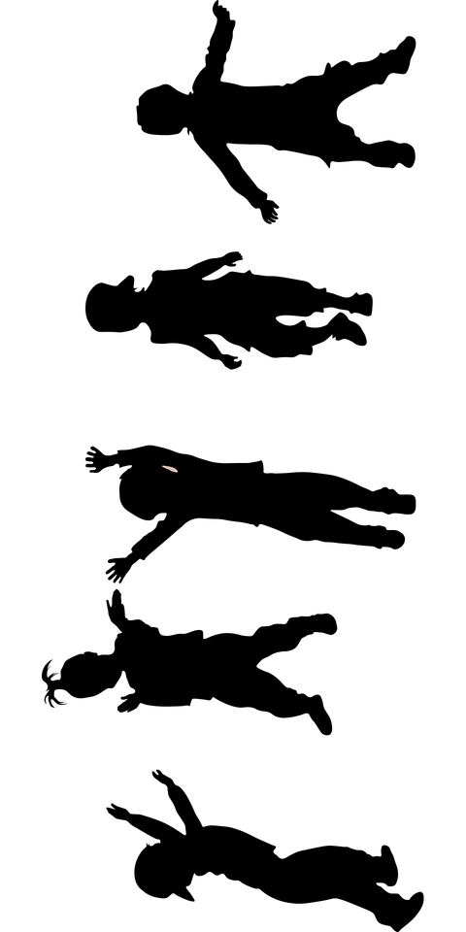
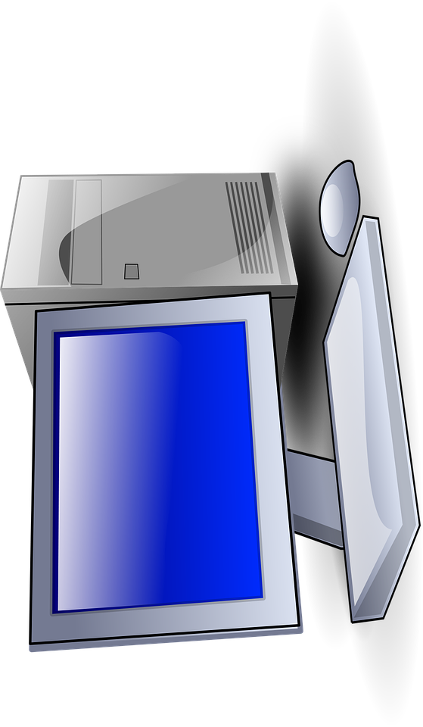
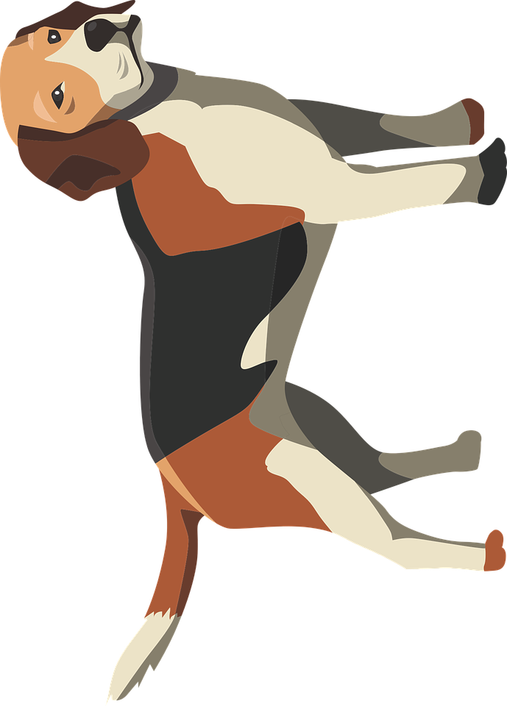
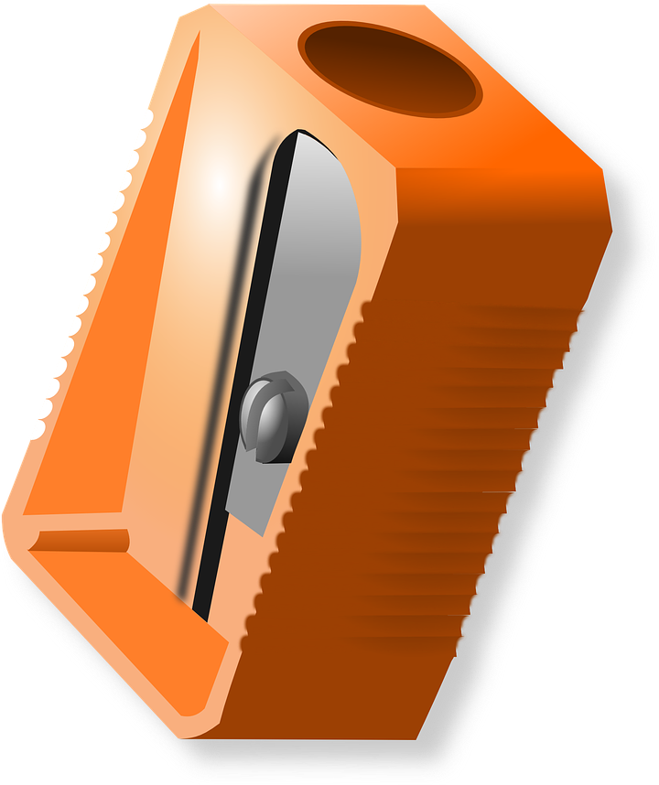
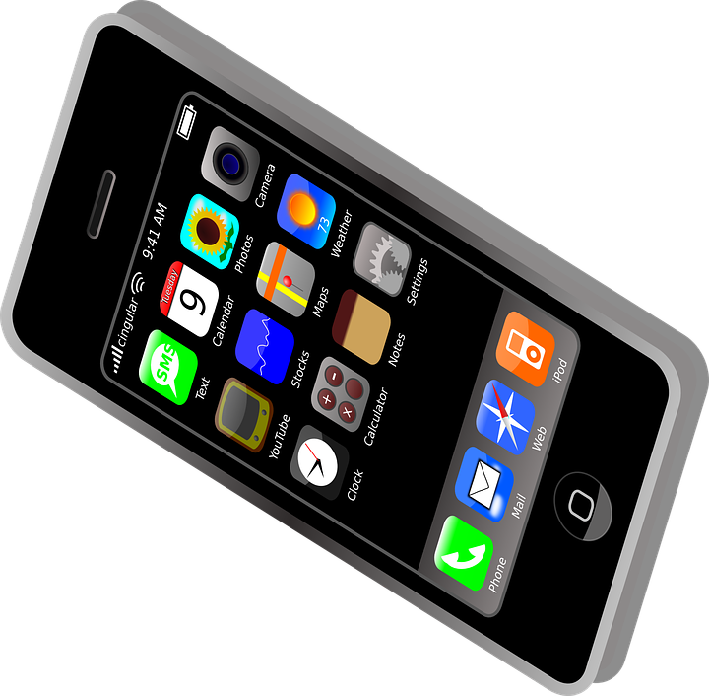

Notes:
Tree: https://pixabay.com/vectors/tree-forest-trunk-nature-leaves-576847/
Laptop: https://pixabay.com/vectors/laptop-notebook-mobile-computer-154091/
People: https://pixabay.com/illustrations/kids-silhouette-party-children-3297107/
Dog: https://pixabay.com/illustrations/dog-hound-mammal-animal-pet-puppy-2404286/
Desktop computer: https://pixabay.com/vectors/computer-desktop-pc-workstation-1295529/
Sun: https://pixabay.com/vectors/cloud-weather-forecast-weather-sky-346710/
Glue: https://pixabay.com/illustrations/glue-pool-adhesive-fixed-1135242/
Flower: https://pixabay.com/vectors/flower-water-lily-lily-lotus-159951/

